Slide 1
Understanding analytics and Big data
Unit-3 p-1

Slide 2
Comparing Reporting and Analysis
An organisation often requires both reporting and analysis to explore new business insights from big data.
A very common mistake organisations make is to relate reporting with analysis.
For this, it is essential to know the difference between a report and an analysis.

Slide 3
Reporting
A reporting environment is also known as Business intelligence(BI) environment.
Such an environment enables users to select and view reports, run them , and view the results.
Reports might contain various visual elements to aid understandability, including graphs, charts, and tables.

Slide 4
Key factors that define a report
They provide the data that the user has been asking for.
They provide the data in a predefined format for easy understandability.
They show the stakeholders what had happened in the past.

Slide 5
Analysis
An Analysis refers to a process that involves a person trying to solve a problem, finding the data required to obtain the required answer, analyzing the data, and interpreting the results to suggest a recommended course of action.

Slide 6
Important points that define an analysis
It provides answers to the questions being raised.
It provides the steps required to get answers to the questions.
The analysis is specific to the questions being addressed.
Analysis requires a person who guides the process.

Slide 7
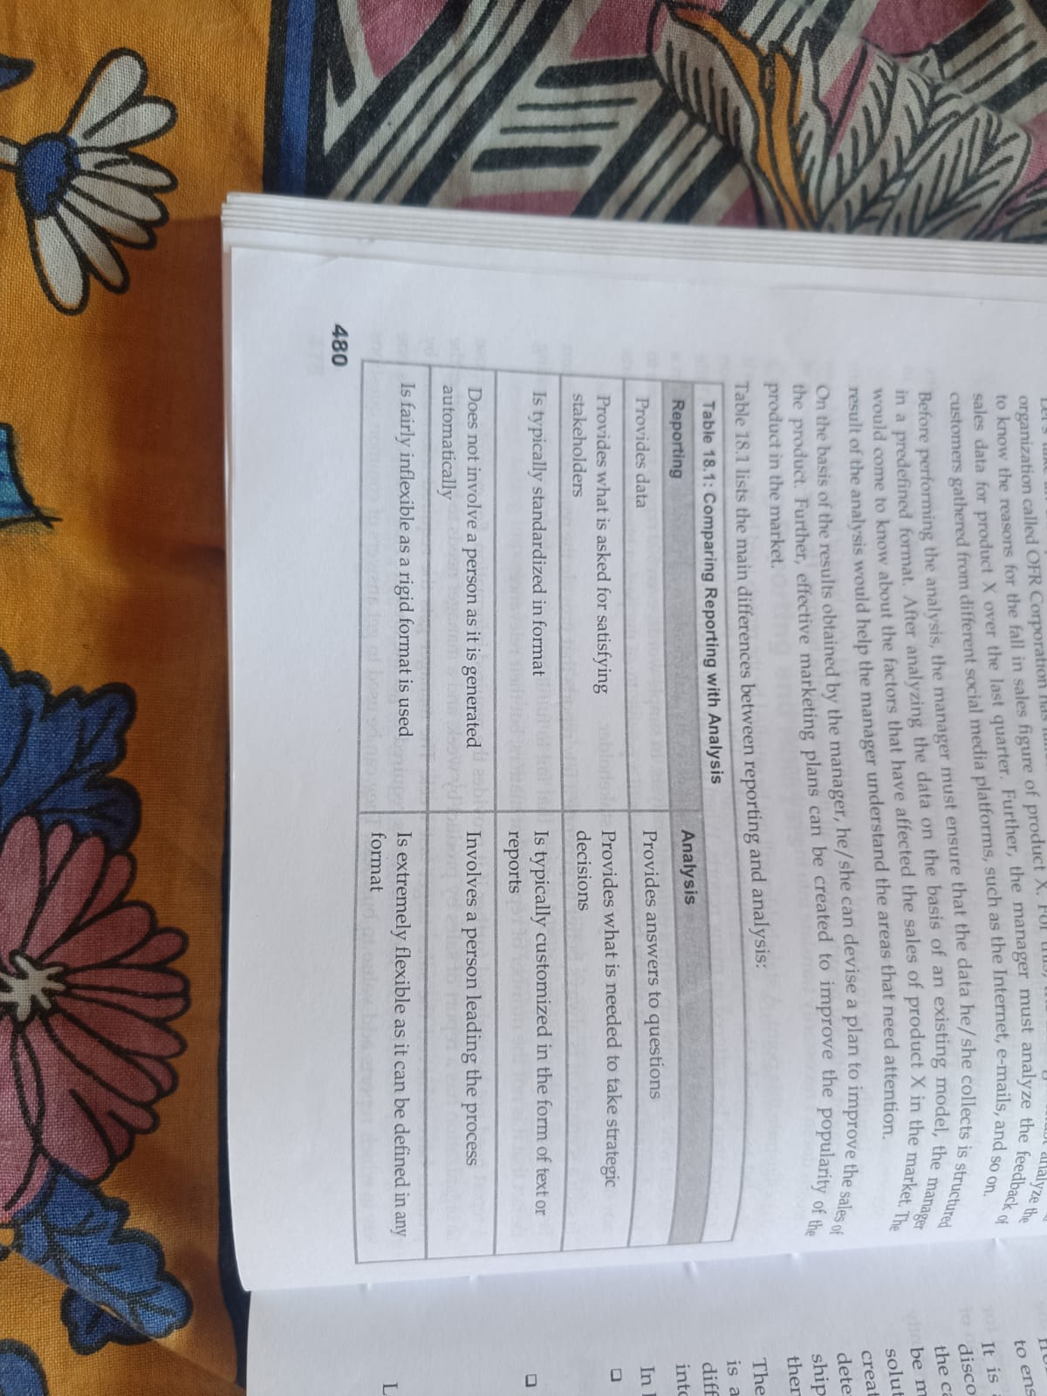
Reporting Vs Analysis

Slide 8
In big data, Analytics is viewed from two perspectives
Decision-oriented analysis: This approach is also called the traditional business intelligence approach.
It tries to use the results of the analysis in the process of making business decisions.

Slide 9
Action-oriented analysis: This approach is used when a rapid response or an action is expected to a critical situation.
A particular pattern emerges or specific types of data are detected and an appropriate action is required to be taken.

Slide 10
The Analytic process
This process contains all or some of the following phases.
1. Business understanding:
It involves identifying and understanding the business objectives.
It deals with the problems to be solved and decisions to be made.
The main goal is to enhance business profitability.

Slide 11
Once the business objectives are determined, the analysts evaluate the situation, and identify the data mining goals.
According to the defined goals, a project plan is created between the analytics team and the IT or development team.
2. Data collection:
Data from different data sources is collected first and then described in terms of its application and need of the project.

Slide 12
This process is also called as data exploration, which is required to ensure the quality of the collected data.
3. Data preparation:
Unnecessary or unwanted data is to be removed in this phase.
4. Data modelling:
A model is created, which is used to analyse the relationships between different selected objects in the data.

Slide 13
Test cases are created to assess the applicability of model and data is structured according to the model.
5. Data evaluation:
Results are evaluated and reviewed for errors.
Analysis reports are created for determining the next plan of action.
6. Deployment:
Plan is finalised and deployed plan is constantly checked for errors and maintenance.
Also called as reviewing of the project.

Slide 14
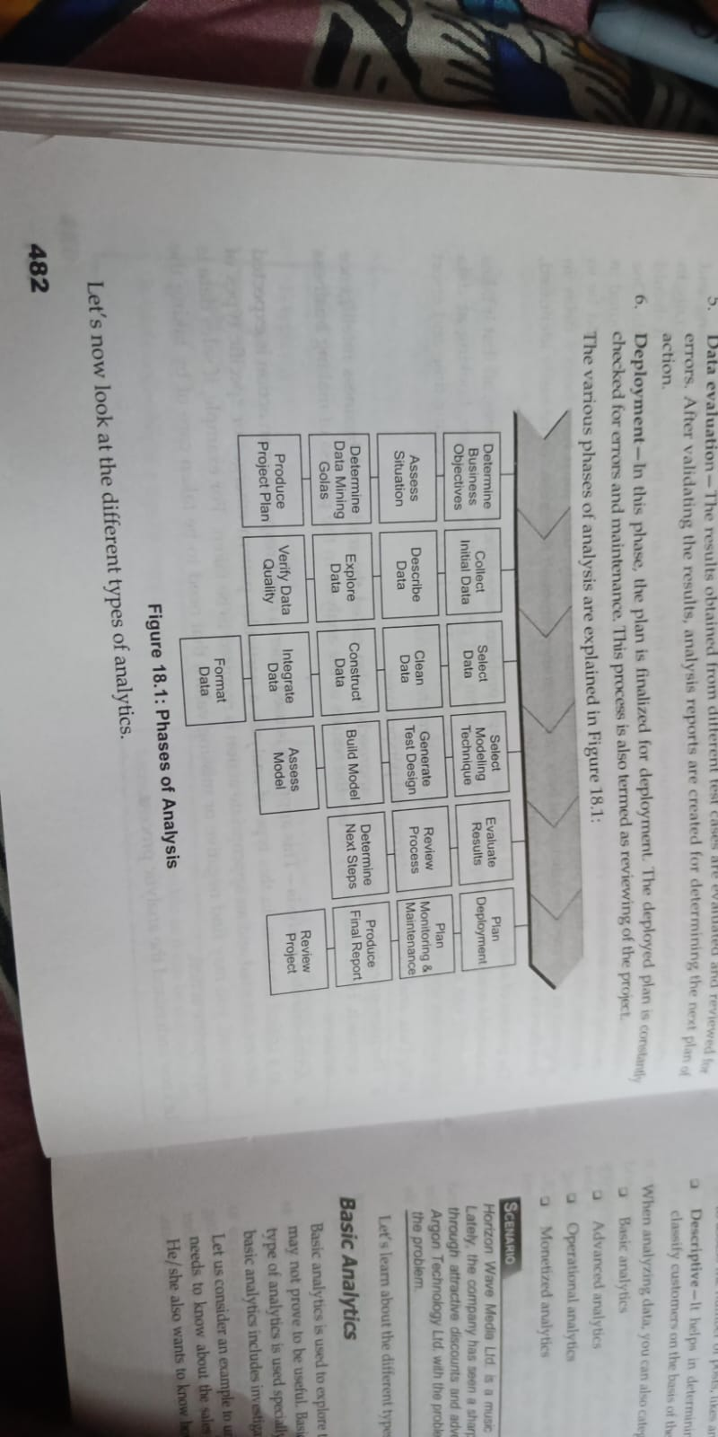

Slide 15
Types of analytics
Prescriptive: The best course of action for a given situation.
Predictive: Future is predicted based on past patterns
Diagnostic: What has happened and why
Descriptive: What is happening

Slide 16
When analysing data, you can also categorise Big data analytics as follows:
Basic analytics
Advanced analytics
Operational analytics
Monetized analytics

Slide 17
Basic analytics
Used to explore the data whose value is not known.
Data may or may not prove to be useful.
Includes investigating what happened, when it is happened and its impact.
Eg:
Slicing and dicing, basic monitoring, Anamoly identification

Slide 18
Advanced analytics
Finding reason for What has happened and the measures that can be taken to avoid it from happening again in the future.
Performs complex analysis of both structured and unstructured data by using algorithms.
Eg:
Predictive modeling, Text analytics, Other statistical and data mining algorithms

Slide 19
Operational analytics
Operational analytics means making analytics important part of the business process.
For instance, in a company a model may be used to predict customers who can be good targets for selling products when they make calls.
While an agent is taking a call from a customer, he/she might receive a message about additional products to sell to the customer.
In such cases, the agent might not be aware that a predictive model is working behind the scenes to make product recommendations.

Slide 20
Monetized analytics
It helps businesses to take important and better decisions and helps earn revenues.
Data of different types such as text-messaging data, location data, billing data and web data are used to find inferences about customer behaviour patterns.
These patterns will help the retailers in finding useful information.

Slide 21
Characteristics of Big data
It can be programmatic.
It can be data-driven.
It can use a lot of attributes.
It can be iterative.

Slide 22
Points to consider during analysis
Frame the problem correctly.
Statistical significance or Business importance?
Making inferences Vs Computing statistics

Slide 23
Frame the problem correctly
It is important to ask the right question to solve a problem, gather the right data, design the right analysis to solve the problem and have a great analysis.

Slide 24
Statistical significance
It is usually used to calculate averages, percentages, parameter estimates arising out of statistical models.
It ensures that your data does not provide irrelevant information.
It ensures right inferences are derived from data.

Slide 25
Business Importance
Assume that statistical significance found in analysis, following questions must be answered.
Is there a statistically significant result that is fantastic?
Is it critical for the business to function?
Is it result large enough to have a meaningful impact?
The results thus obtained must always be placed in a business context to take it as a final process of validation.

Slide 26
Making inferences Vs Computing statistics
The analytical professional must know what should be done as a result.
The analyst must have an idea of the potential plan of action to understand what can be done about findings.
If analysis fails to support, then it should be documented.

Slide 27
Developing an Analytics team
Following questions must be answered.
How should an organisation structure its analytics team?
Where does the teams fit in the organisation?
What will set the organisation up for the most success?

Slide 28
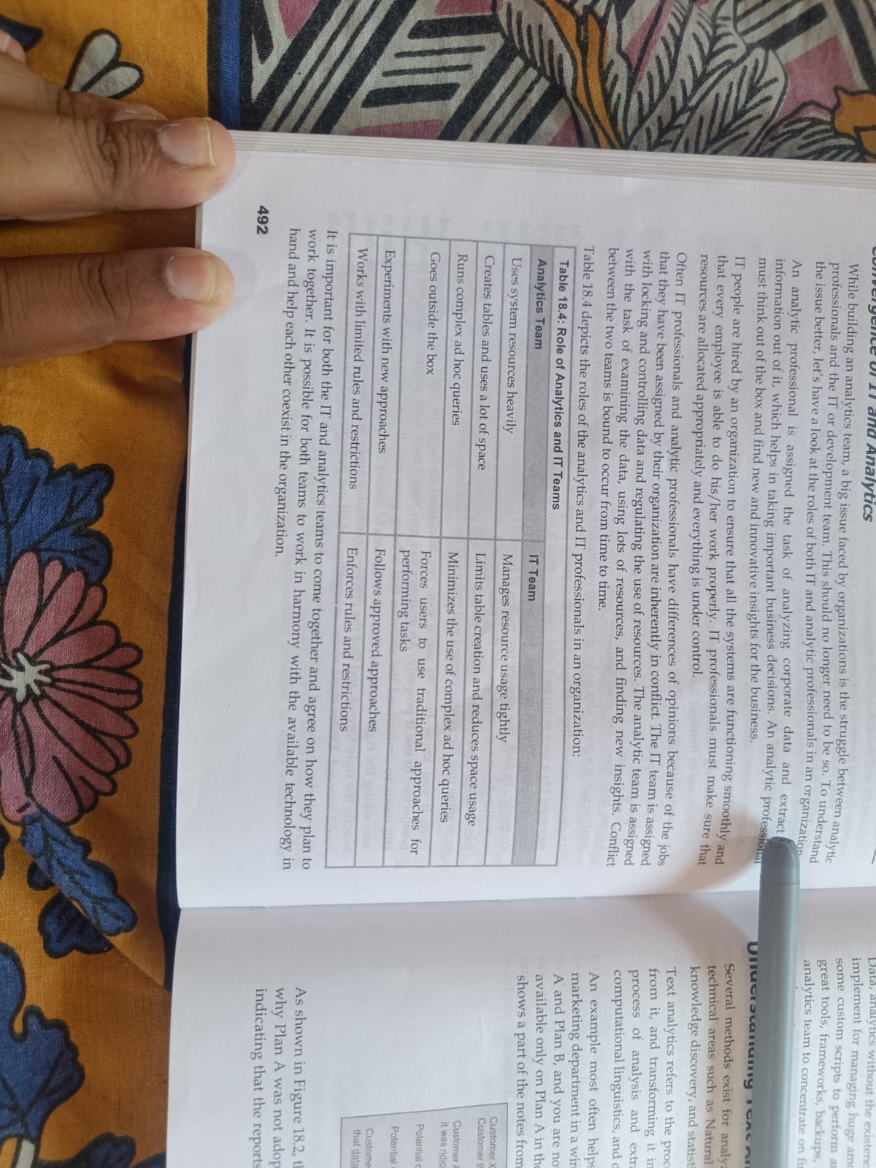
Convergence of IT and analytics

Slide 29
Understanding text analytics
It refers to the process of analyzing unstructured text, taking out relevant information from it and transforming it into structured information.
Techniques such as NLP, data mining, information retrieval, knowledge discovery and statistics are used.

